Slide 1
Session 3
Hbase, Hive, Pig Hadoop workshop
Dr. Péter Molnár
Saeid Motevali
Institute for Insight
J. Mack Robinson College of Business
Georgia State University

Slide 2
Background:
How we get into big data
Distributed memory
Shared memory
Package size (coin example)
SuperCube

Slide 3
Area effected by parallel processing:
Since we have a big data need to process it in parallel
Datamining such as tweets analysists
Image processing training set
Algorithm
Networking

Slide 4
Map Reduce Optimization:
Before for example just English word.
On load change the compression ratio, how big the size.
Map Done by code, Don’t want to use high complex.
Shuffle highly complex, if you are good try it.
Reduce reducing process.
After just give the first result fast, and use the data again for further processing.
Tweet example

Slide 5
Optimization Before Running a job:
File size. Use the right size.
Compression. How much can compress and how it does effect the processing. Text Transfer example.
Encryption. Encrypting and decrypting takes time

Slide 6
Physical Map Reduce:
Verify your cluster configuration, and document the reason if not using default.
Unused resources
Overstress resources ( can’t fit in memory and goes to desk)
Collaboration of local and web data storage

Slide 7
Reducer Optimization:
Subdividing tasks prevent over flow of memory
Debugging provided on the nodes that has been used unlike mapper
Spill ration define how much it goes to disk

Slide 8
What is Pig? ETL library for Hadoop. Extract Transform Load Generate MapReduce Developed at Yahoo

Slide 9
Example:
Transform the data: By dividing sentence and collecting word. Classic word count for blog.
Clean and filtering the data: Such as data for sensor that needs to be clean.
Process the data: For example data for specific location that you may need.

Slide 10
How Does Pig Works:
Load <file>
Filter, Join, Group By, Foreach, Generate <values>
Dump <to screen for testing>
Store <new file>

Slide 11
Pig data:
Field: a piece of data
Tuple: a set of field
Bag: a collection of tuples
Pig is complete relation database.

Slide 12
Pig Concepts:
Filter <set> By <value> = <number>
Filter A by quantity > 2000;
Similar to where in relational database
Supported operations :
Logical: NOT, AND, OR
Relational: < , > , == , != , >= , <=

Slide 13
Pig Function:
It is quite powerful and rich, it is worth digging into it.
General: AVG, MAX, TOKENIZE
Relational: FILTER, MAPREDUCE. can call MAPREDUCE inside a pig script.
String: UPERCASE, LOWERCASE
Math: ABS, LOG, ROUND
Write your own function (Write, Register, Test the function in JAVA or PYTHON)

Slide 14
Run Pig:
Run from Hadoop or pig shell
Use as embedded within the java code
We should think about mapper and reducer in our code.

Slide 15
What is Hive?
SQL-like query language that generates MapReduce Code.
Hive use H-SQL (Hibernate Query Language)
Developed at Facebook
Batch, not interactive. means takes time to come up with result.
It is open source.

Slide 16
NoSql:
Object oriented
Beyond the relational database
Horizontal Scaling, building out instead of up
mapping

Slide 17
What is HBase?
Wide-column NoSQL database.
Use CREATE TABLE over HDFS data.
It is very different from relational database
It is distributed, multidimensional sorted map.
Using Hive With Hadoop:
Hive library are integrated with Hbase.
Hive libraries include the HQL language.

Slide 18
Why Use Hive?
You are an analyst and you know SQL.
You want to ask analytical question.
You work with excel.
Hive is batch, not interactive. It does produce MapReduce. So, takes time.
You don’t want to do word count by Hive. Pig works better in that manner.

Slide 19
For Hive Query Optimization:
Partitioning or sampling using subset.
Cost-based optimization (CBO) by looking at execution method and locating bottleneck.

Slide 20
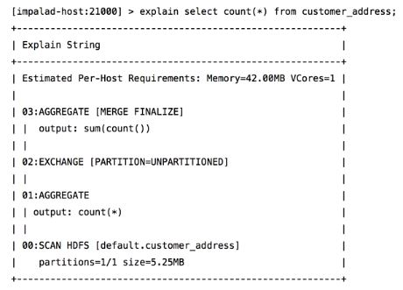
HQL Query Plan:

Slide 21
Pig vs Hive
Has a protocol data flow
language called pig Latin
Mainly used for programming
Generally used by researchers and programmers
pig SQL-Like takes time to get expert
Has a declarative SQLish
language called HiveQL
Mainly used for creating report
Used by data analysists
Close to SQL can be learned faster

Slide 22


Slide 23
Works To Do:
Fire up your vmware or your virtualbox.
If you have no memory open cloudera.
Open the browser and type the address.
Use maria_dev as your username and password
Go to this link and go through the steps for Pig:
http://hortonworks.com/hadoop-tutorial/how-to-process-data-with-apache-pig/
Go to this link and go through the steps for Hive:
http://hortonworks.com/hadoop-tutorial/how-to-process-data-with-apache-hive/

Slide 24
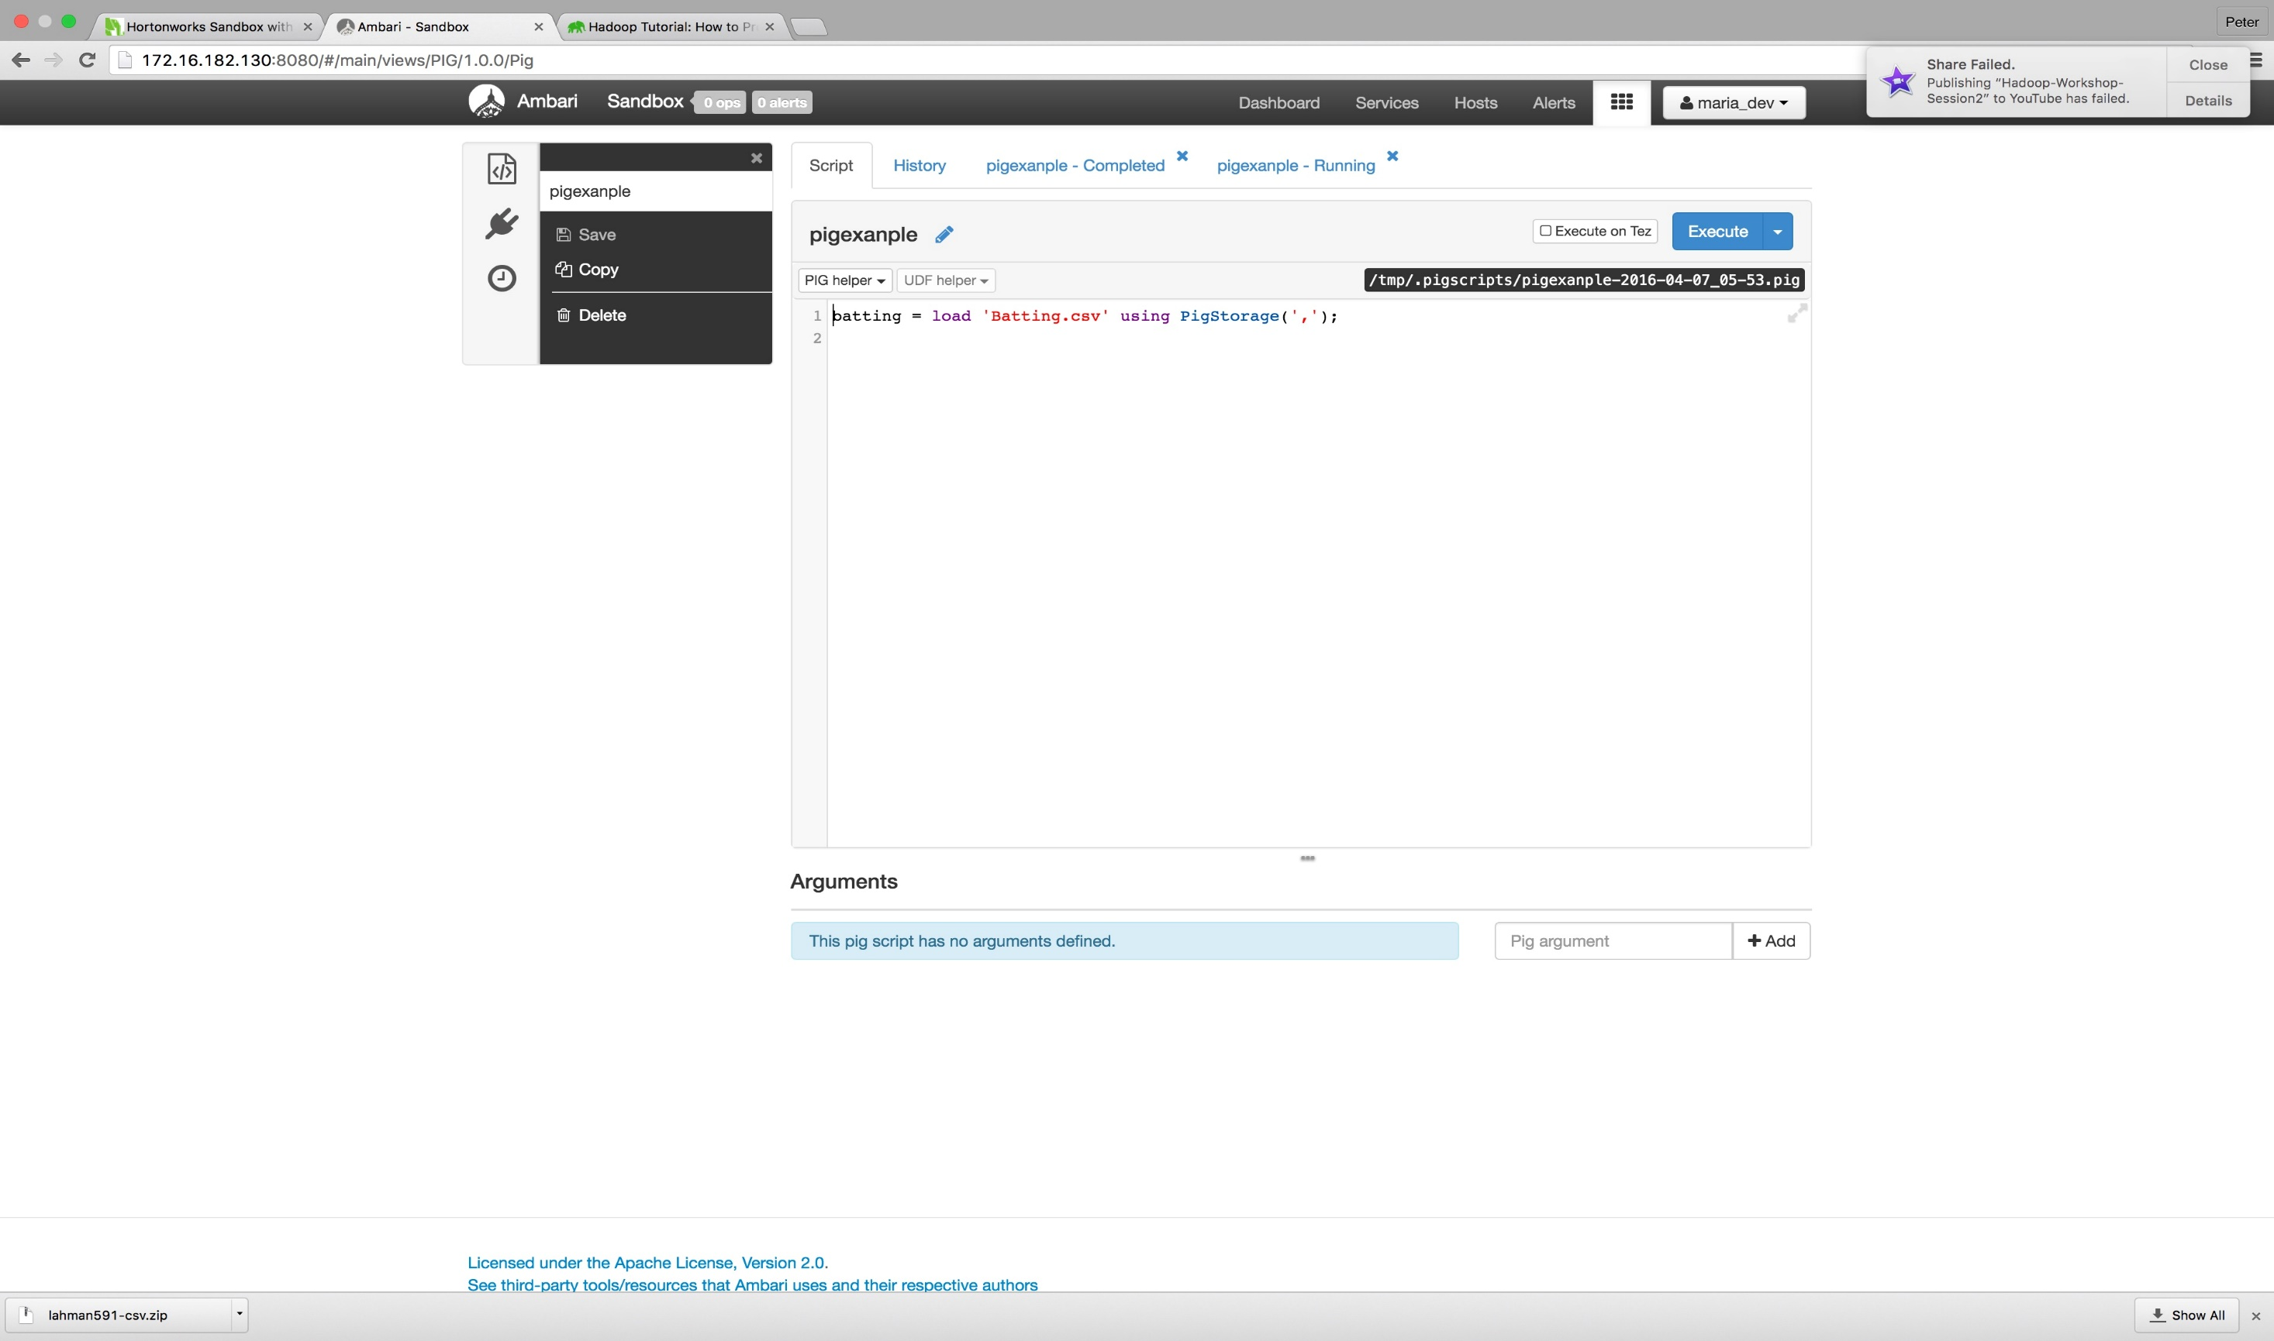

Slide 25
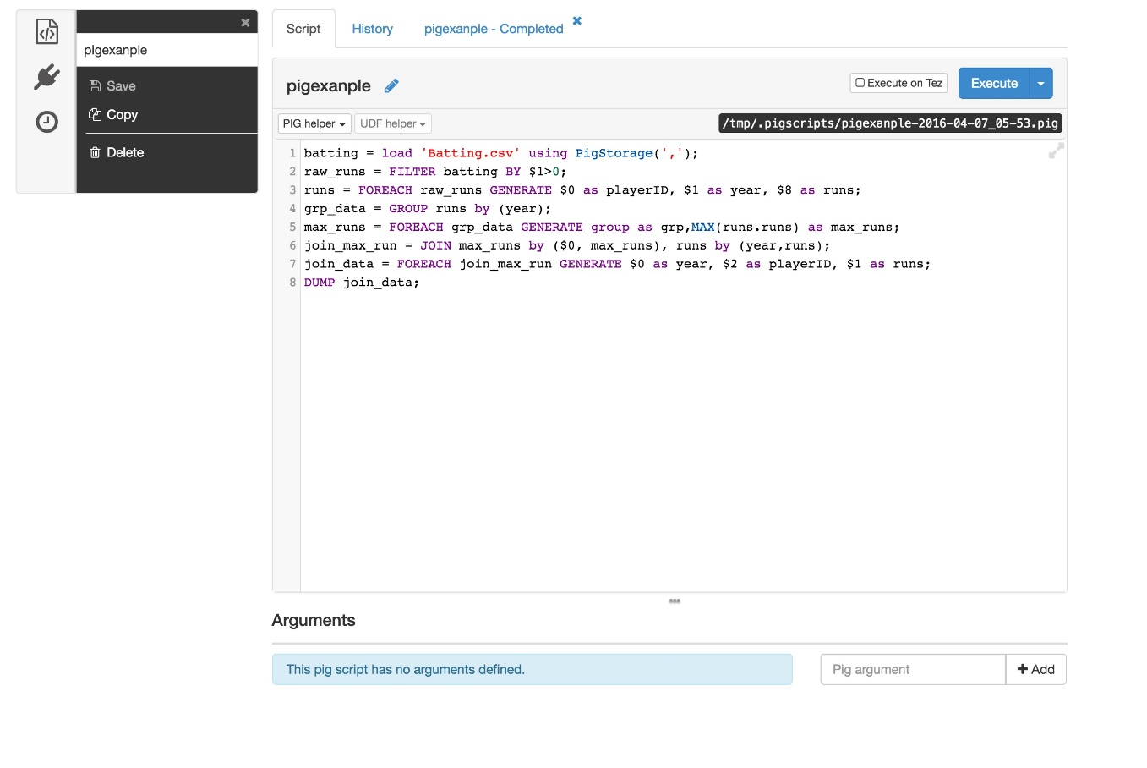

Slide 26
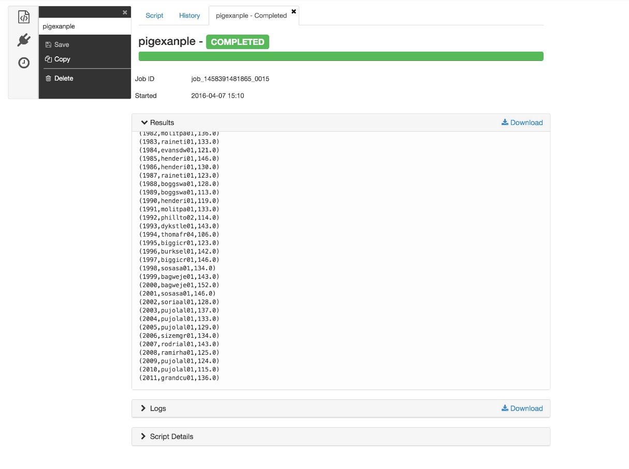

Slide 27
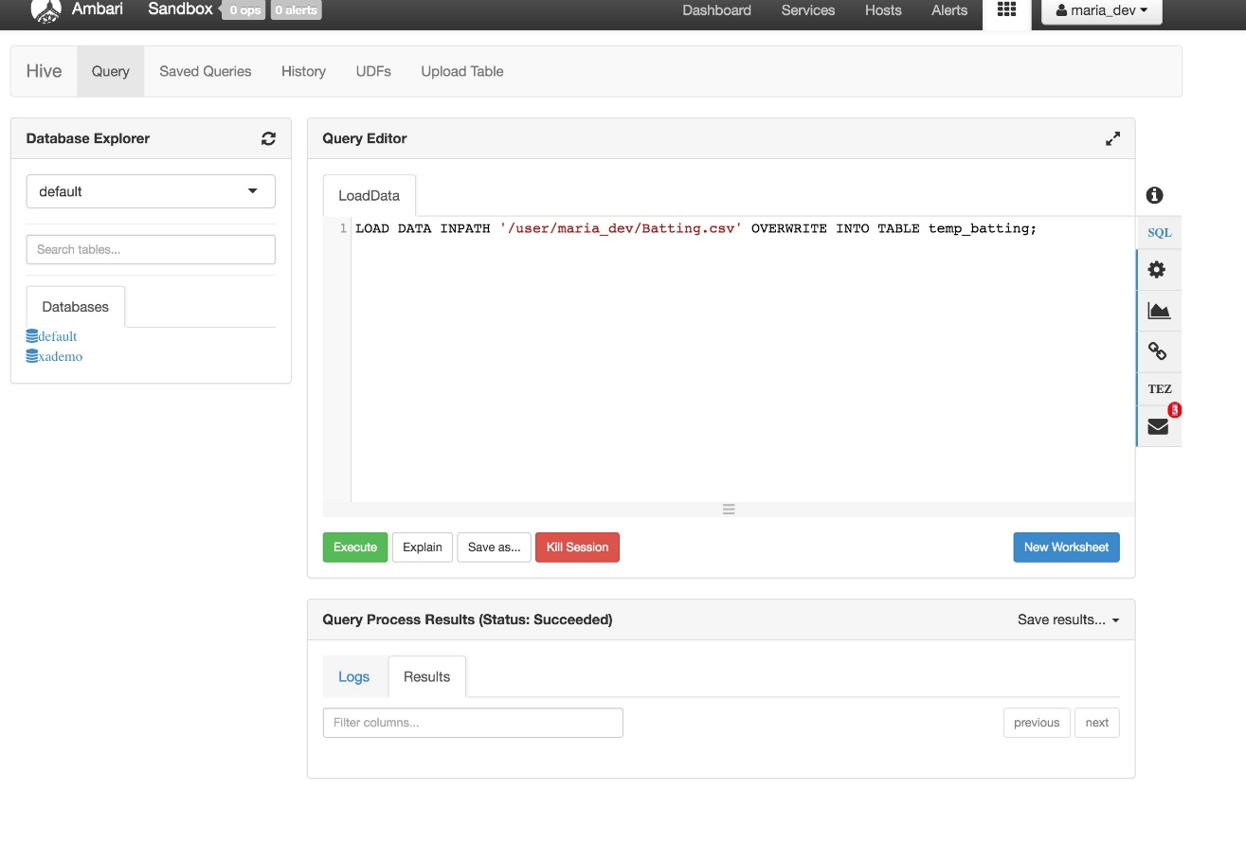

Slide 28
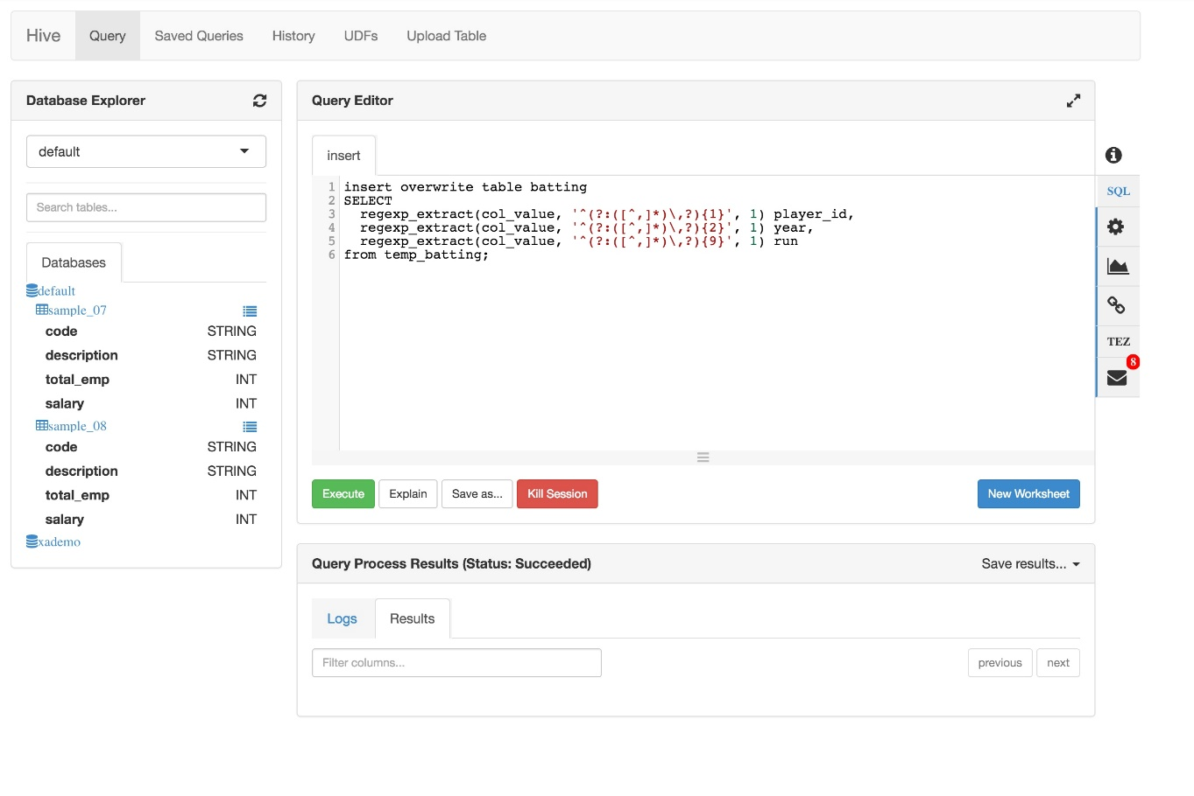

Slide 29
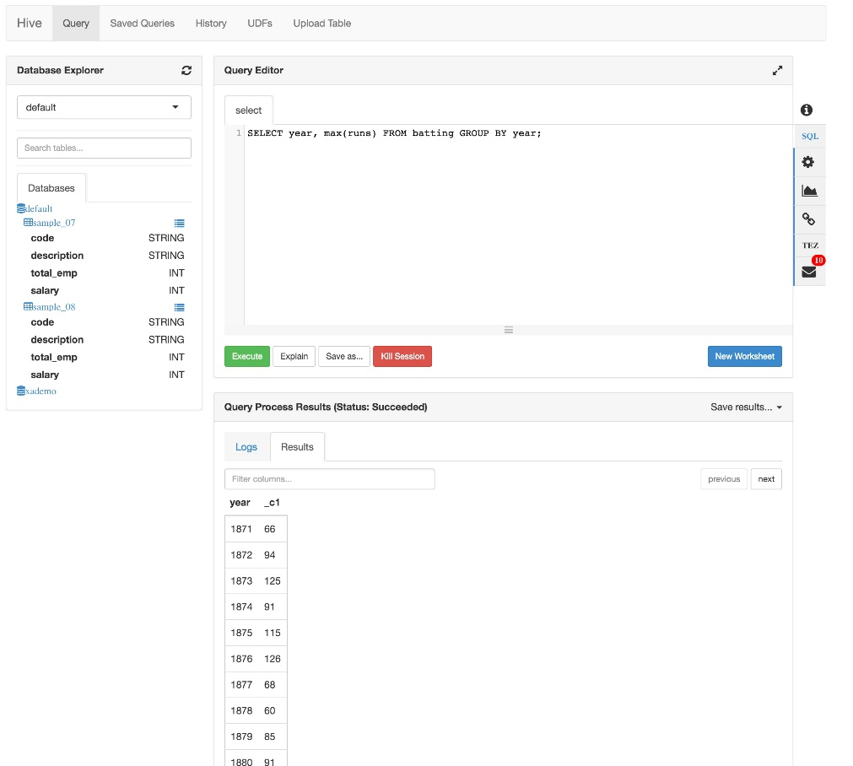

Slide 30
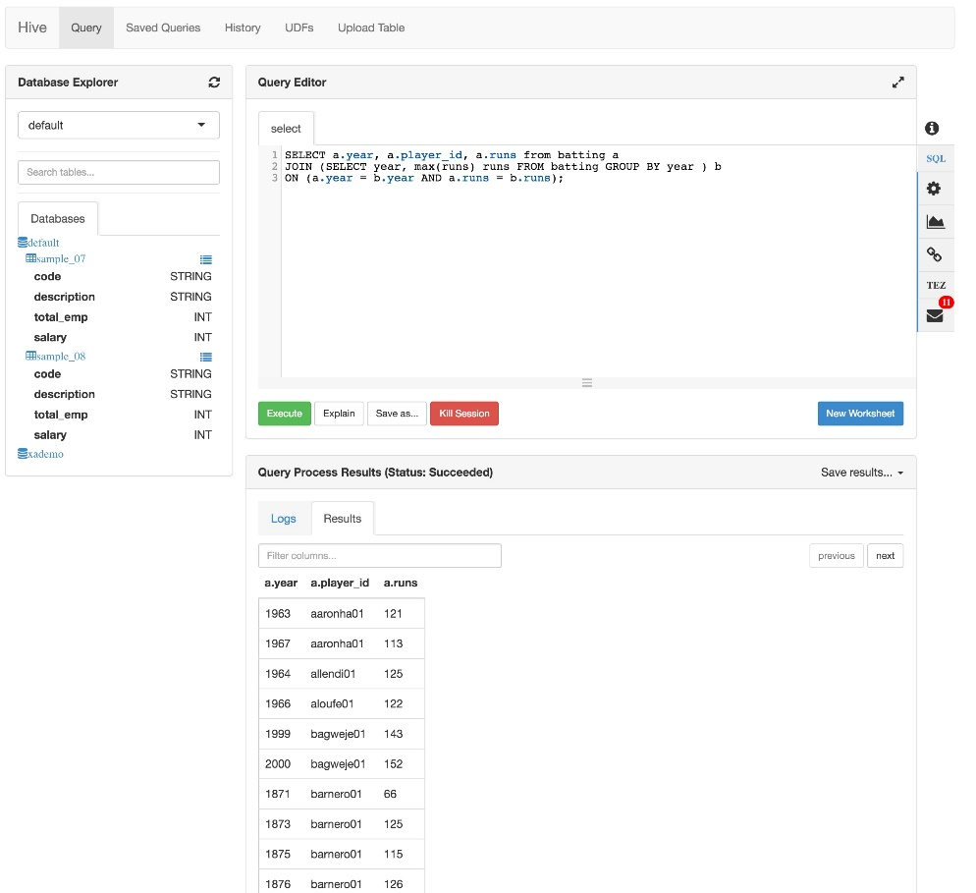

Slide 31
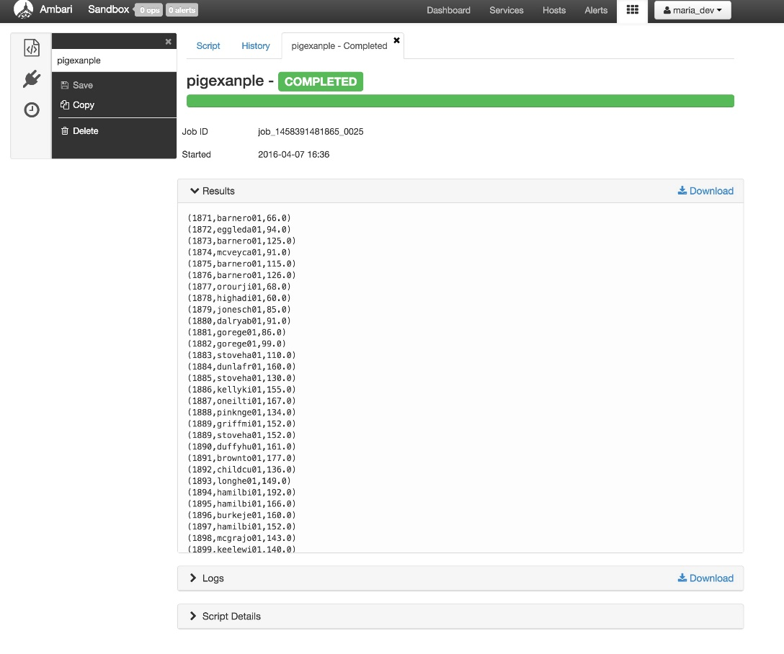

Slide 32


